Slide 1
Mobile TCP
CEG436: Mobile Computing Prabhaker Mateti

Slide 2
TCP RFCs: 793, 1122, 1323, 2018, 2581
Connection-oriented
Point-to-point: one sender, one receiver processes
send & receive buffers
Flow control: Do not flood the receiver’s buffer
Congestion control: Do not stress the network by sending too much too fast
Full-duplex Byte-Stream
transport in both directions.
To an application these appear as two unrelated data streams, although TCP does piggyback control and data (such as an ACK).
reliable, in-order byte steam: no “message boundaries”
Kurose and Ross, Ch 3

Slide 3
TCP Connection
Four Numbers: Source IP Address, Source Port, Destination IP Address, Destination Port
“Open”
TCP three-way handshake.
OS of both source and destination hosts begin to maintain “state information” re the connection.
“connection is established”
“Close”: TCP Four-Way Handshake.
Terminates a previously established connection.
OS of both source and destination hosts flush out “state information” re the connection.
“connection is closed”
Data transport only between Open and Close.

Slide 4
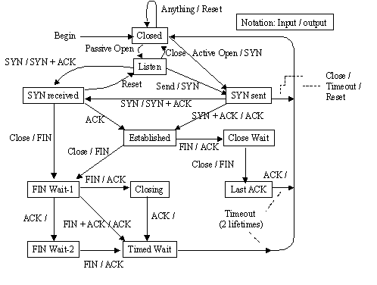
TCP State Diagram

Slide 5
TCP States
CLOSE-WAIT | Waits for a connection termination request from the remote host.
CLOSED | Represents no connection state at all.
CLOSING | Waits for a connection termination request acknowledgment from the remote host.
ESTABLISHED | Connection is ready, data received can be delivered to the process. The normal state for data transfer.
FIN-WAIT-1 | Waits for a connection termination request from the remote host or an acknowledgment of the connection termination request previously sent.
FIN-WAIT-2 | Waits for a connection termination request from the remote host.
LAST-ACK | Waits for an acknowledgment of the connection termination request previously sent to the remote host (which includes an acknowledgment of its connection termination request).
LISTEN | Waits for a connection request from any remote TCP port.
SYN-RECEIVED | Waits for a confirming connection request acknowledgment after having both received and sent a connection request.
SYN-SENT | Waits for a matching connection request after having sent a connection request.
TIME-WAIT | Waits for enough time to pass to be sure the remote host received the acknowledgment of its connection termination request.

Slide 6
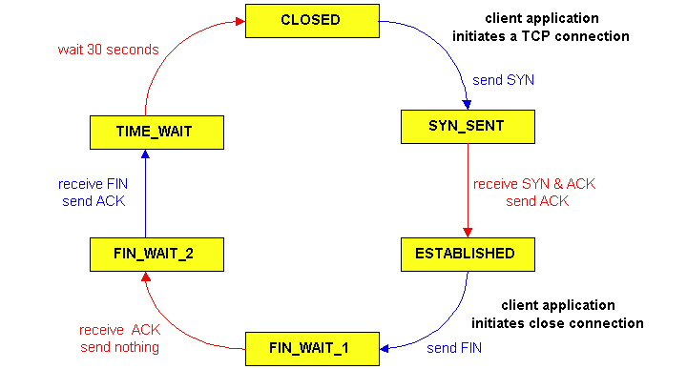
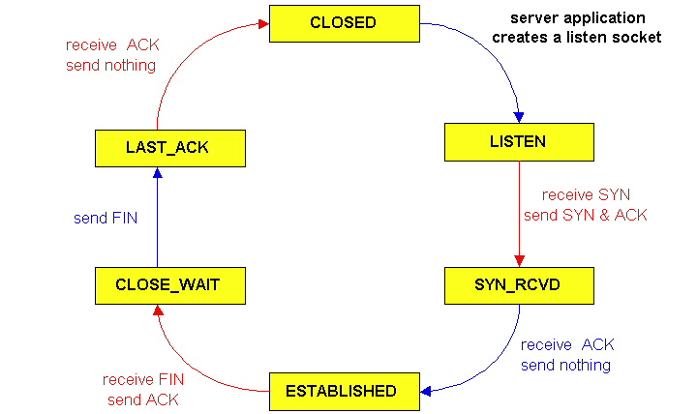
TCP Connection Management
TCP client
TCP server

Slide 7
TCP Segment
00 | 01 | 02 | 03 | 04 | 05 | 06 | 07 | 08 | 09 | 10 | 11 | 12 | 13 | 14 | 15 | 16 | 17 | 18 | 19 | 20 | 21 | 22 | 23 | 24 | 25 | 26 | 27 | 28 | 29 | 30 | 31
Source Port |  |  |  |  |  |  |  |  |  |  |  |  |  |  |  | Destination Port
Sequence Number
Acknowledgment Number
doffset |  |  |  | 000 |  |  | ECN |  |  | Control Bits |  |  |  |  |  | Window
Checksum |  |  |  |  |  |  |  |  |  |  |  |  |  |  |  | Urgent Pointer
Options and padding :::
Data :::

Slide 8
TCP Segments
TCP segment = TCP Header + data payload from the byte stream
TCP asks IP to deliver
Does not include IP addresses
Header details below
Control Bits
URG: Urgent “out of band”
PSH: Push No-wait
ACK: Ack Number Present
RST: Reset the connection
SYN: Start of SEQ number
FIN: No more from sender
Checksum: error checking
ECN, Explicit Congestion Notification. 3 bits.
Options. 0 to 40 bytes.
Port Numbers
A number that OS uses
Reserved Ports; e.g.,
22 for SSH
80 for HTTP
443 for HTTP/SSL
Source Port Number
Dest Port Number
SEQuence Number
The “positional” number of the first data byte in this segment
except when SYN is 1.
ACK Number
value of the next SEQ the sender of the segment is expecting to receive.
Window size of sliding window at sender of packet

Slide 9
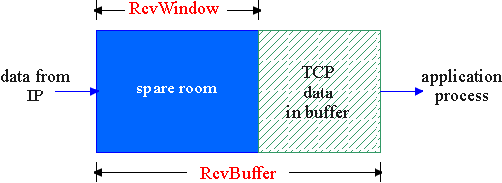
TCP Flow Control
Sender won’t overflow receiver’s buffer by transmitting too much, too fast
Sliding window
Receiver advertises spare room by including value of RcvWindow in segments
Sender limits unACKed data to RcvWindow
guarantees receive buffer doesn’t overflow

Slide 10
TCP Flow Control
Sender
Receiver
Flow Control Can Limit Throughput
Throughput is wnd/rtt
wnd = 1200
500 bytes
500 bytes
wnd = 200
Sender
Receiver
200 bytes
t
wnd bytes
wnd = 500
rtt
500 bytes

Slide 11
TCP Congestion Control
“too many sources sending too much data too fast for network to handle”
Congestion is about network
Flow control is between sender/receiver only.
Congestion manifestations
lost packets (buffers full at routers)
long delays (queuing in router buffers)
End-end congestion control
no explicit feedback from network
congestion inferred from end-system observed loss, delay
Network-assisted control
routers provide feedback to end systems
single bit indicating congestion (SNA, DECbit, TCP/IP ECN, ATM)
explicit rate sender should send at

Slide 12
TCP Congestion Control
packet loss in fixed networks typically due to (temporary) overload situations
routers have to discard packets when the buffers are full
TCP recognizes congestion only indirectly via missing acknowledgements, retransmits unwisely, contributes to further congestion
slow-start algorithm as reaction

Slide 13
Congestion Avoidance
Congestion avoidance (flow control) was added to TCP in an attempt to reduce congestion inside the network
Requires the cooperation of multiple senders
Must rely on indirect measures of congestion
Implemented at sender
Src
Dest
Attempts to reduce buffer overflow inside the network

Slide 14
Slow Start: Exponential Increase
The goal of the slow start mechanism is to detect and avoid congestion as a connection begins or after a timeout
start with a congestion window cwnd, size equal to one segment
doubles cwnd, if no loss occurs, up to the congestion threshold, then linear increase
TCP Reno every round-trip time
TCP Vegas every other round-trip time
missing ACK causes
congestion threshold set to one half of the cwnd
cwnd starts again with one segment
Slow start is active if cwnd ≤ ssthresh

Slide 15
Retransmission Upon Timeout
RTO == retransmission time-out timer for each segment
Dynamically updated based on RTT
When timed out: either got corrupted or lost
Segment is retransmitted
Three dup ACK rule:
Retransmit missing segment immediately
“fast retransmission”

Slide 16
TCP Problems with Wireless
Packet loss typically due to
Bit errors due to wireless channel impairments
Handoffs can cause packet loss
Possibly congestion, but not often
Bursts of errors due to low signal strength or longer periods of noise
More than one packet lost in TCP
More likely to be detected as a timeout ⇒ enter slow start!
Delay is often very long
Round-trip time can be very long and variable
Timeout mechanisms may not work well
Problem exacerbated by link-level retransmission
Links may be asymmetric
Delayed ACKs in the slow direction can limit throughput in the fast direction
TCP originally designed for fixed end-systems and fixed/wired networks
TCP assumes packet loss is due to
Congestion in the network
Packet reordering, but not often
TCP’s mechanisms do not respond well to packet loss due to bit errors or handoffs
TCP assumes congestion if packets are dropped
typically wrong in wireless networks, here we often have packet loss due to transmission errors
The performance of an unchanged TCP degrades severely
however, TCP cannot be changed fundamentally due to the large base of installations in the fixed network, TCP for mobility has to remain compatible
the basic TCP mechanisms keep the whole Internet together

Slide 17
Example Hand-Off Procedure
Each base station periodically transmits beacon
Mobile host, on hearing stronger beacon from a new BS, sends it a greeting
changes routing tables to make new BS its default gateway
sends new BS identity of the old BS
New BS acknowledges the greeting, and begins to route the MH’s packets
New BS informs old BS
Old BS changes routing table, to forward any packets for the MH to the new BS
Old BS sends an ack to new BS
New BS sends handoff-completion message to MH

Slide 18
Hand-off
Hand-offs may result in temporary loss of route to MH
with non-overlapping cells, it may be a while before the mobile host receives a beacon from the new FA/BS
While routes are being reestablished during handoff, MH and old FA/BS may attempt to send packets to each other, resulting in loss of packets
Frequent handoffs a problem for schemes that rely on significant amount of hard/soft state at base stations
hard state should not be lost
soft state needs to be recreated to benefit performance
If link layer performs hand-offs and guarantees reliability despite handoff, then TCP will not be aware of the handoff
except for potential delays during handoff
If hand-off visible to IP
Need Mobile IP
packets may be lost while a new route is being established reliably despite handoff

Slide 19
“Mobile TCP”
Mobile IPv4: More than 30 RFCs
RFC5944 IP Mobility Support for IPv4, Nov 2010
Mobile IPv6: More than 40 RFCs
RFC6342 Mobile Networks … for IPv6 Aug 2011
There are no “Mobile TCP” RFCs.
There are many RFCs that modify TCP based on mobility issues
Solution Approaches
Link-layer approaches
Split-connection approaches
End-to-end approaches
Indirect TCP
Snoop TCP
M-TCP
T/TCP, SACK,
Transmission/time-out freezing, …

Slide 20
Schiller Mobile Communications Chapter 9: Mobile Transport Layer
Motivation, TCP-mechanisms
Classical approaches (Indirect TCP, Snooping TCP, Mobile TCP)
PEPs in general
Additional optimizations (Fast retransmit/recovery, Transmission freezing, Selective retransmission, Transaction oriented TCP)
TCP for 2.5G/3G wireless

Slide 21
Transport Layer
Client
Server
E.g. HTTP (used by web services) typically uses TCP
Reliable transport between client and server required
TCP
Steam oriented, not transaction oriented
Network friendly: time-out ➔ congestion ➔ slow down transmission
Well known – TCP guesses quite often wrong in wireless and mobile networks
Packet loss due to transmission errors
Packet loss due to change of network
Result
Severe performance degradation
TCP SYN
TCP SYN/ACK
Connection
setup
TCP ACK
HTTP request
Data
transmission
HTTP response
>15 s
no data
GPRS: 500ms!
Connection
release

Slide 22
TCP Reconsidered
TCP originally designed for
Fixed end-systems
Fixed, wired networks
Research activities
Performance
Congestion control
Efficient retransmissions
TCP congestion control
packet loss in fixed networks typically due to (temporary) overload situations
router have to discard packets as soon as the buffers are full
TCP recognizes congestion only indirect via missing acknowledgements, retransmissions unwise, they would only contribute to the congestion and make it even worse
slow-start algorithm as reaction

Slide 23
TCP Reconsidered
TCP slow-start algorithm
sender calculates a congestion window for a receiver
start with a congestion window size equal to one segment
exponential increase of the congestion window up to the congestion threshold, then linear increase
missing acknowledgement causes the reduction of the congestion threshold to one half of the current congestion window
congestion window starts again with one segment
TCP fast retransmit/fast recovery
TCP sends an acknowledgement only after receiving a packet
if a sender receives several acknowledgements for the same packet, this is due to a gap in received packets at the receiver
however, the receiver got all packets up to the gap and is actually receiving packets
therefore, packet loss is not due to congestion, continue with current congestion window (do not use slow-start)

Slide 24
Mobility on TCP mechanisms
TCP assumes congestion if packets are dropped
typically wrong in wireless networks, here we often have packet loss due to transmission errors
furthermore, mobility itself can cause packet loss, if e.g. a mobile node roams from one access point (e.g. foreign agent in Mobile IP) to another while there are still packets in transit to the wrong access point and forwarding is not possible
The performance of an unchanged TCP degrades severely
however, TCP cannot be changed fundamentally due to the large base of installation in the fixed network, TCP for mobility has to remain compatible
the basic TCP mechanisms keep the whole Internet together

Slide 25
Indirect TCP I
Indirect TCP or I-TCP segments the connection
no changes to the TCP protocol for hosts connected to the wired Internet, millions of computers use (variants of) this protocol
optimized TCP protocol for mobile hosts
splitting of the TCP connection at, e.g., the foreign agent into 2 TCP connections, no real end-to-end connection any longer
hosts in the fixed part of the net do not notice the characteristics of the wireless part
.
mobile host
access point
(foreign agent)
„wired“ Internet
„wireless“ TCP
standard TCP

Slide 26
I-TCP socket and state migration
access point₁
socket migration
and state transfer
Internet
access point₂
mobile host

Slide 27
Indirect TCP II
Advantages
no changes in the fixed network necessary, no changes for the hosts (TCP protocol) necessary, all current optimizations to TCP still work
transmission errors on the wireless link do not propagate into the fixed network
simple to control, mobile TCP is used only for one hop between, e.g., a foreign agent and mobile host
therefore, a very fast retransmission of packets is possible, the short delay on the mobile hop is known
Disadvantages
loss of end-to-end semantics, an acknowledgement to a sender does now not any longer mean that a receiver really got a packet, foreign agents might crash
higher latency possible due to buffering of data within the foreign agent and forwarding to a new foreign agent

Slide 28
Snooping TCP I
“Transparent” extension of TCP within the foreign agent
buffering of packets sent to the mobile host
lost packets on the wireless link (both directions!) will be retransmitted immediately by the mobile host or foreign agent, respectively (so called “local” retransmission)
the foreign agent therefore “snoops” the packet flow and recognizes acknowledgements in both directions, it also filters ACKs
changes of TCP only within the foreign agent
.
local retransmission
correspondent
host
foreign
agent
„wired“ Internet
snooping of ACKs
buffering of data
mobile
host
end-to-end TCP connection

Slide 29
Snooping TCP II
Data transfer to the mobile host
FA buffers data until it receives ACK of the MH, FA detects packet loss via duplicated ACKs or time-out
fast retransmission possible, transparent for the fixed network
Data transfer from the mobile host
FA detects packet loss on the wireless link via sequence numbers, FA answers directly with a NACK to the MH
MH can now retransmit data with only a very short delay
Integration of the MAC layer
MAC layer often has similar mechanisms to those of TCP
thus, the MAC layer can already detect duplicated packets due to retransmissions and discard them
Problems
snooping TCP does not isolate the wireless link as good as I-TCP
snooping might be useless depending on encryption schemes

Slide 30
M-TCP
Special handling of lengthy and/or frequent disconnections
M-TCP splits as I-TCP does
unmodified TCP fixed network to supervisory host (SH)
optimized TCP SH to MH
Supervisory host
no caching, no retransmission
monitors all packets, if disconnection detected
set sender window size to 0
sender automatically goes into persistent mode
old or new SH reopen the window
Advantages
maintains semantics, supports disconnection, no buffer forwarding
Disadvantages
loss on wireless link propagated into fixed network
adapted TCP on wireless link

Slide 31
Fast retransmit/fast recovery
Change of foreign agent often results in packet loss
TCP reacts with slow-start although there is no congestion
Forced fast retransmit
as soon as the mobile host has registered with a new foreign agent, the MH sends duplicated acknowledgements on purpose
this forces the fast retransmit mode at the communication partners
additionally, the TCP on the MH is forced to continue sending with the actual window size and not to go into slow-start after registration
Advantage
simple changes result in significant higher performance
Disadvantage
further mix of IP and TCP, no transparent approach

Slide 32
Transmission/time-out freezing
Mobile hosts can be disconnected for a longer time
no packet exchange possible, e.g., in a tunnel, disconnection due to overloaded cells or mux. with higher priority traffic
TCP disconnects after time-out completely
TCP freezing
MAC layer is often able to detect interruption in advance
MAC can inform TCP layer of upcoming loss of connection
TCP stops sending, but does now not assume a congested link
MAC layer signals again if reconnected
Advantage
scheme is independent of data
Disadvantage
TCP on mobile host has to be changed, mechanism depends on MAC layer

Slide 33
Selective retransmission
TCP acknowledgements are often cumulative
ACK n acknowledges correct and in-sequence receipt of packets up to n
if single packets are missing quite often a whole packet sequence beginning at the gap has to be retransmitted (go-back-n), thus wasting bandwidth
Selective retransmission as one solution
RFC2018 allows for acknowledgements of single packets, not only acknowledgements of in-sequence packet streams without gaps
sender can now retransmit only the missing packets
Advantage
much higher efficiency
Disadvantage
more complex software in a receiver, more buffer needed at the receiver

Slide 34
Transaction oriented TCP
TCP phases
connection setup, data transmission, connection release
using 3-way-handshake needs 3 packets for setup and release, respectively
thus, even short messages need a minimum of 7 packets!
Transaction oriented TCP
RFC1644, T-TCP, describes a TCP version to avoid this overhead
connection setup, data transfer and connection release can be combined
thus, only 2 or 3 packets are needed
Advantage
efficiency
Disadvantage
requires changed TCP
mobility not longer transparent

Slide 35
TCP over 2.5/3G wireless networks
Fine tuning today’s TCP
Learn to live with
Data rates: 64 kbit/s up, 115-384 kbit/s down; asymmetry: 3-6, but also up to 1000 (broadcast systems), periodic allocation/release of channels
High latency, high jitter, packet loss
Suggestions
Large (initial) sending windows, large maximum transfer unit, selective acknowledgement, explicit congestion notification, time stamp, no header compression
Widespread use
i-mode running over FOMA
WAP 2.0 (“TCP with wireless profile”)

Slide 36
Performance Enhancing Proxies
Mobile system
RFC 3135
Transport layer
Local retransmissions and acknowledgements
Additionally on the application layer
Content filtering, compression, picture downscaling
E.g., Internet/WAP gateways
Web service gateways?
Big problem: breaks end-to-end semantics
Disables use of IP security
Choose between PEP and security!
RFC 3150 (slow links)
Recommends header compression, no timestamp
RFC 3155 (links with errors)
States that explicit congestion notification cannot be used
wireless
PEP
Internet
Comm. partner

Slide 37
Comparison of “mobile” TCPs

Slide 38
Summary
TCP is a complex protocol
Minimal support from underlying protocols
Indirect observation of network environment
Large number of competing flows from different hosts
Congestion avoidance is still a research issue
TCP does not perform well in a wireless environment where packets are usually lost due to bit errors, not congestion
Schemes have been proposed to address TCP performance problems
Link-level recovery
Split protocols
End-to-end protocols

Slide 39
References
Jochen Schiller, Mobile Communications, Ch 9 Mobile Transport Layer
Mark Grayson, Kevin Shatzkamer, and Klaas Wierenga, Building the Mobile Internet, Ch 6 Transport/Session Layer Mobility safaribooksonline…

